Slide 1
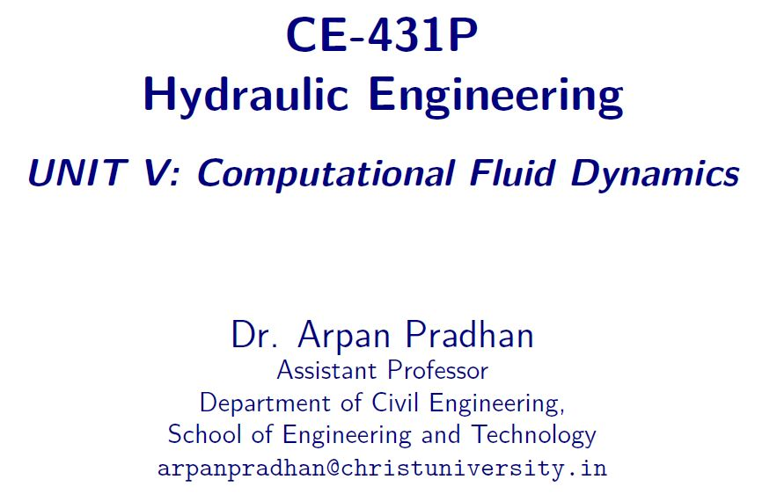

Slide 2
Contents
What is Computational Fluid Dynamics?
Why use CFD?
Where is CFD used?

Slide 3
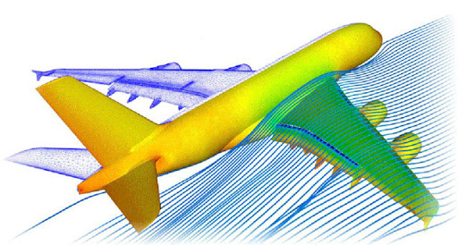
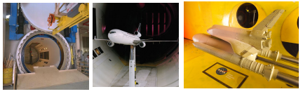
Experimental fluid dynamics
Experimental studies are performed with laboratory-scale models.
The amount of information is limited and the costs are very high.
There are measurement errors and disturbances caused by probes.

Slide 4
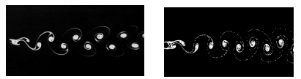
Computational Fluid Dynamics
The Euler and Navier-Stokes equations have been known since 1755 (resp. since 1827). No closed-form solutions are available to date……
Numerical methods can be used to calculate approximate solutions
Computational Fluid Dynamics makes it possible to perform detailed numerical simulations of fluid flows in a “virtual flow laboratory”
von Karman vortex street CFD simulation

Slide 5
What is computational fluid dynamics?
Computational fluid dynamics (CFD) is the science of predicting fluid flow, heat transfer, mass transfer, chemical reactions, and related phenomena by solving the mathematical equations which govern these processes using a numerical process.
The result of CFD Analyses is relevant engineering data used in
  Detailed Product Development.
  Conceptual Studies of New Designs.
  Troubleshooting.
  Redesign.
CFD analysis Compliments Testing and Experimentation.
  Reduces the total effort required in the laboratory.

Slide 6
Why USE computational fluid dynamics?
Numerical simulations of fluid flow (will) enable
architects to design comfortable and safe living environments
designers of vehicles to improve the aerodynamic characteristics
chemical engineers to maximize the yield from their equipment
petroleum engineers to devise optimal oil recovery strategies
surgeons to cure arterial diseases (computational hemodynamics)
meteorologists to forecast the weather and warn of natural disasters
safety experts to reduce health risks from radiation and other hazards
military organizations to develop weapons and estimate the damage

Slide 7
Experiments v/s Simulations
CFD gives an insight into flow patterns that are difficult, expensive or impossible to study using traditional (experimental) techniques
Experiments | Simulations
Quantitative description of flow phenomena using measurements | Quantitative prediction of flow phenomena using CFD software
for one quantity at a time at a limited number of points and time instants for a laboratory-scale model for a limited range of flow problems and operating conditions | for all desired quantities with high resolution in space and time for the actual flow domain for virtually any problem and realistic operating conditions
Error sources: measurement errors, flow disturbances by the probes | Error sources: modeling, discretization, iteration, implementation

Slide 8
Experiments v/s Simulations
CFD does not replace the measurements completely but the amount of experimentation and the overall cost can be significantly reduced
Experiments | Simulations
expensive slow sequential Single purpose | cheap(er) fast(er) parallel Multiple-purpose
Equipment and personnel are difficult to transport | CFD software is portable, easy to use and modify

Slide 9
Experiments v/s Simulations
The results of a CFD simulation are never 100% reliable
the input data may involve too much guessing or imprecision
mathematical model of the problem at hand may be inadequate
the quality of numerical solutions depends on the accuracy of approximation techniques and available computing power

Slide 10
Where IS cfd used
Aerospace
Appliances
Automotive
Biomedical
Chemical Processing
HVAC&R
Marine
Defense Industry
Oil & Gas
Power Generation
Sports
Hazard Analysis

Slide 11
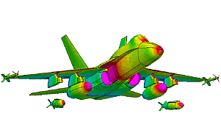
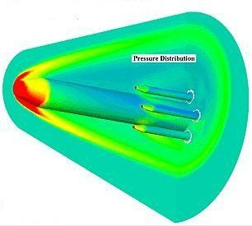
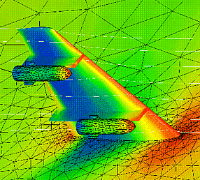
Where IS cfd used
Aerospace
Appliances
Automotive
Biomedical
Chemical Processing
HVAC&R
Marine
Defense Industry
Oil & Gas
Power Generation
Sports
Hazard Analysis

Slide 12
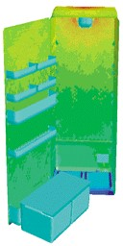
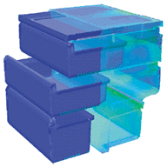
Where IS cfd used
Aerospace
Appliances
Automotive
Biomedical
Chemical Processing
HVAC&R
Marine
Defense Industry
Oil & Gas
Power Generation
Sports
Hazard Analysis
Surface-heat-flux plots of the No-Frost refrigerator and freezer compartments helped BOSCH-SIEMENS engineers to optimize the location of air inlets.

Slide 13
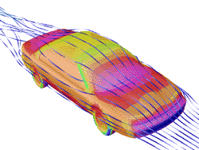
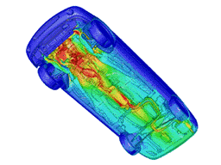
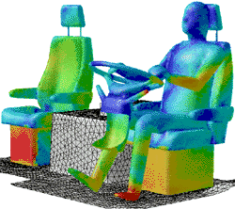
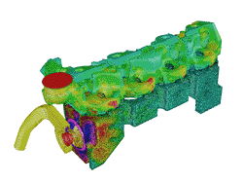
Where IS cfd used
Aerospace
Appliances
Automotive
Biomedical
Chemical Processing
HVAC&R
Marine
Defense Industry
Oil & Gas
Power Generation
Sports
Hazard Analysis
External Aerodynamics Undercarriage Aerodynamics
Interior Ventilation Engine Cooling

Slide 14
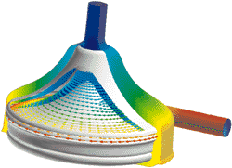
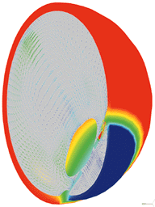
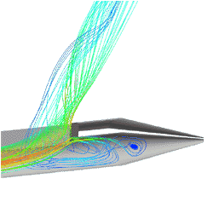
Where IS cfd used
Aerospace
Appliances
Automotive
Biomedical
Chemical Processing
HVAC&R
Marine
Defense Industry
Oil & Gas
Power Generation
Sports
Hazard Analysis
Medtronic Blood Pump
Temperature and natural convection currents in the eye following laser heating.
Spinal Catheter

Slide 15
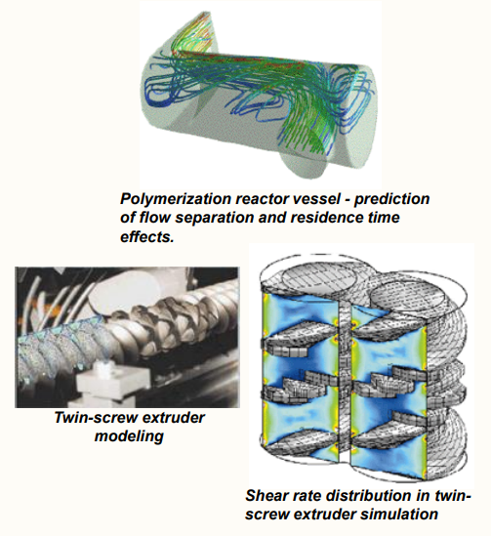
Where IS cfd used
Aerospace
Appliances
Automotive
Biomedical
Chemical Processing
HVAC&R
Marine
Defense Industry
Oil & Gas
Power Generation
Sports
Hazard Analysis

Slide 16
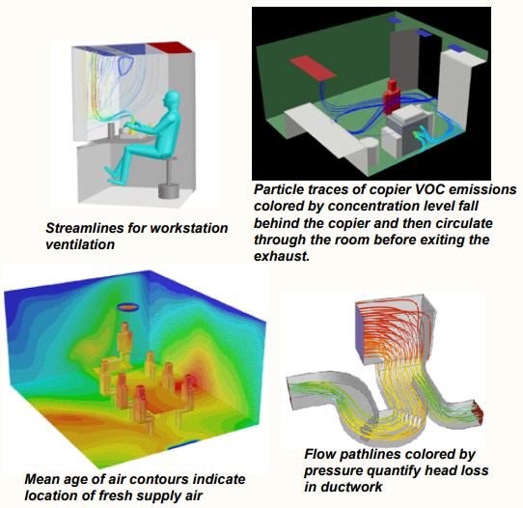
Where IS cfd used
Aerospace
Appliances
Automotive
Biomedical
Chemical Processing
HVAC&R
Marine
Defense Industry
Oil & Gas
Power Generation
Sports
Hazard Analysis

Slide 17
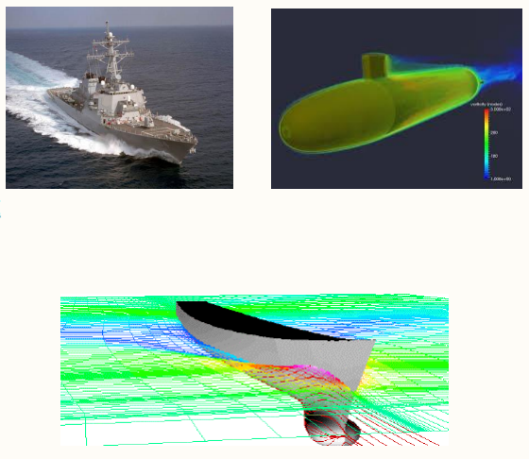
Where IS cfd used
Aerospace
Appliances
Automotive
Biomedical
Chemical Processing
HVAC&R
Marine
Defense Industry
Oil & Gas
Power Generation
Sports
Hazard Analysis

Slide 18
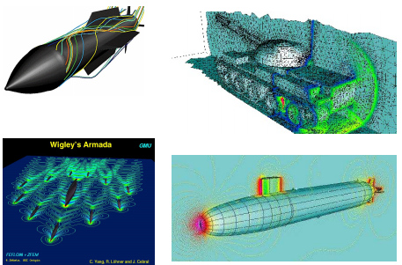
Where IS cfd used
Aerospace
Appliances
Automotive
Biomedical
Chemical Processing
HVAC&R
Marine
Defense Industry
Oil & Gas
Power Generation
Sports
Hazard Analysis

Slide 19
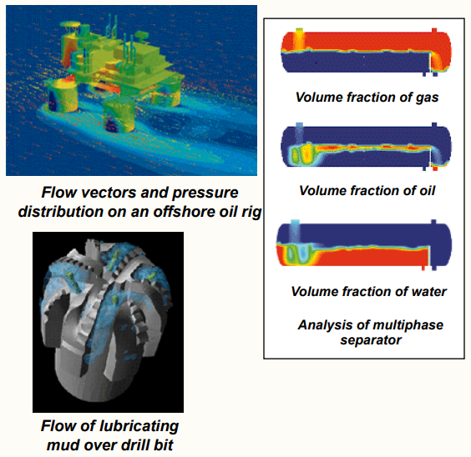
Where IS cfd used
Aerospace
Appliances
Automotive
Biomedical
Chemical Processing
HVAC&R
Marine
Defense Industry
Oil & Gas
Power Generation
Sports
Hazard Analysis

Slide 20
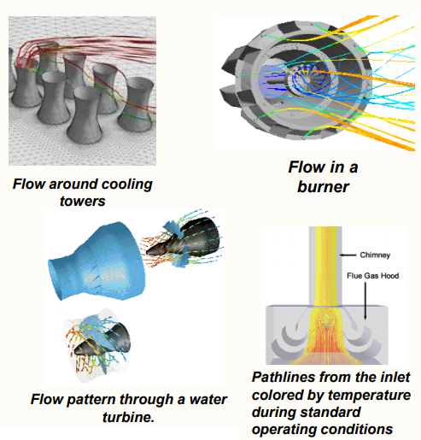
Where IS cfd used
Aerospace
Appliances
Automotive
Biomedical
Chemical Processing
HVAC&R
Marine
Defense Industry
Oil & Gas
Power Generation
Sports
Hazard Analysis

Slide 21
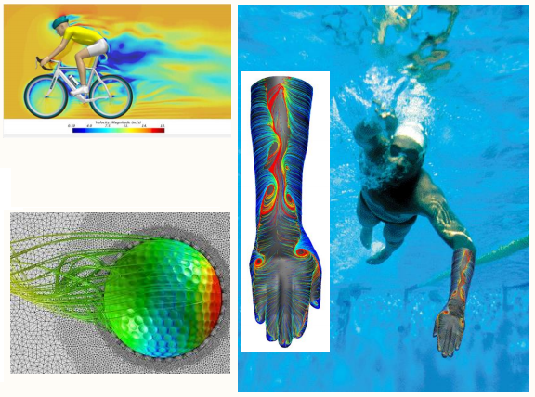
Where IS cfd used
Aerospace
Appliances
Automotive
Biomedical
Chemical Processing
HVAC&R
Marine
Defense Industry
Oil & Gas
Power Generation
Sports
Hazard Analysis

Slide 22
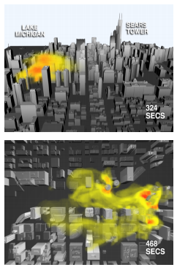
Where IS cfd used
Aerospace
Appliances
Automotive
Biomedical
Chemical Processing
HVAC&R
Marine
Defense Industry
Oil & Gas
Power Generation
Sports
Hazard Analysis

Slide 23
Computational Modeling - Procedure
Model the Geometry and Flow Domain to Formulate the Flow problem
Establish the Boundary and Initial Condition
Generate the Grid
Development of Simulation Solver
Perform Simulation
Monitor the Simulation Convergence
Post process the Simulation and pull out Plots
Make Comparison and Analyze
Repeat process to Examine the Sensitivities

Slide 24
Computational Modeling –
Boundary and Initial condition
Boundary conditions need to finalized with respect to the problem
They are various boundary conditions like Pressure inlet, velocity inlet, Wall, symmetry, axis, pressure outlet etc.,
Usually the calculations starts with the help of initial conditions to reach final solution.
Setting up proper boundary and initial condition will be helpful to avoid divergence in solver.

Slide 25
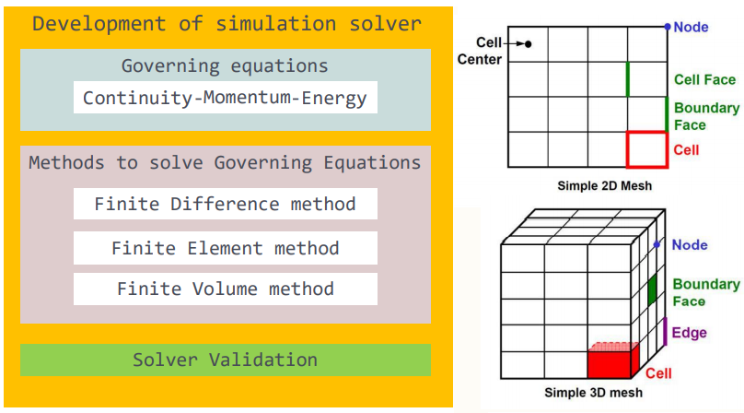
Computational Modeling –
GRID
Grid/Mesh is a set of point distributed over the problem domain for a numerical solution of a set of partial differential equations.
There are several methods to discretize a geometry
Un-structured grid
Structured grid
  Rectangular grids
  Multi block grids
  Overlapping grids.

Slide 26
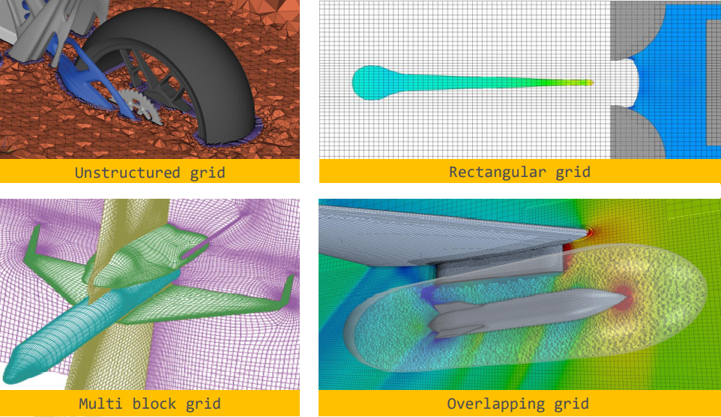
Computational Modeling –
GRID

Slide 27
Computational Modeling –
GRID
  Cell = control volume into which domain is broken up
    computational domain is defined by mesh that represents the fluid and solid regions of interest.
  Face = boundary of a cell
  Edge = boundary of a face
  Node = grid point
  Zone = group of nodes, faces, and/or cells
    Boundary data assigned to face zones.
    Material data and source terms assigned to cell zones.

Slide 28
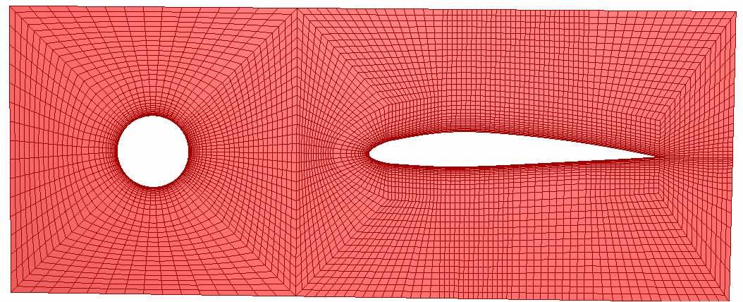
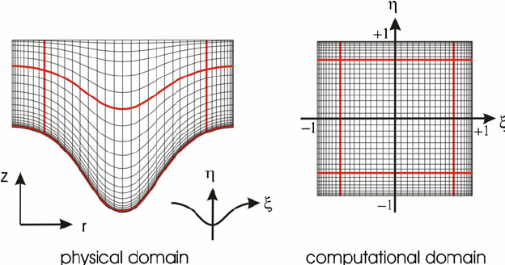
Computational Modeling –
GRID - Structured Grids

Slide 29
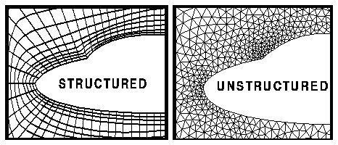
Computational Modeling –
GRID - Unstructured Grids
Unlike structured grids, sides of a cell/element have no relation to the co-ordinate directions in unstructured grids.
The un-structured grid consists of triangles or quadrilateral in 2D and tetrahedra, wedge, hexahedra or polyhedral in 3D.

Slide 30
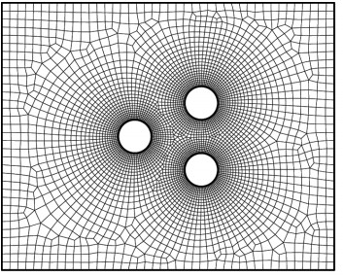
Computational Modeling –
GRID - Unstructured Grids
Unstructured Quad Mesh

Slide 31
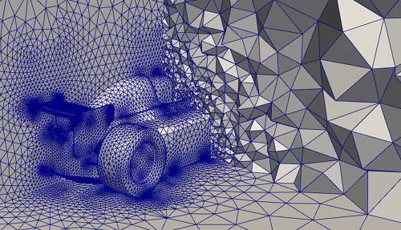
Computational Modeling –
GRID - Unstructured Grids
Polyhedral Mesh

Slide 32
Computational Modeling –
GRID – Generation Process
The process of grid-generation for complex geometries normally involves following steps:
Decompose the problem domain into a set of sub-domains (blocks)
In each block, generate the requisite grid. Typical sequence of operations would be,
  Generate edge-grid
  (i.e. divide the edges of a surface in desired number of one dimensional elements).
  Using the edge grids, generate the grid on the block-surfaces.
  Use surface grids as input to generate volume mesh.
Check mesh quality, and modify the mesh as required.

Slide 33
Computational Modeling – simulation solver

Slide 34
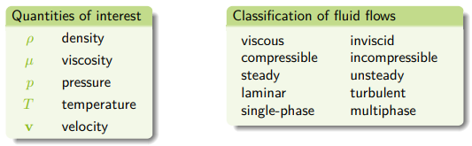
Computational Modeling – fluid characteristic
The reliability of CFD simulations is greater
for laminar/slow flows than for turbulent/fast ones
for single-phase flows than for multi-phase flows
for chemically inert systems than for reactive flows

Slide 35


